Slide 2
When to use slides with your oral presentation?
When you want to put emphasis on certain aspects of your presentation. These keywords or main pieces of information should be the focus of your slides – don’t write down everything, just the keywords or the most important information.
When you have good images that show your ideas or products. If your slides are only full of text, they might be boring to look at.
When you want your audience to have time to look at certain pieces of visual information. A good photo, chart or a graph could say much more than you could say in your speech.

Slide 3
Tips for preparing slides:
Keep your slides clean and simple: use bullet points or arrows to list different pieces of information, but don’t put too much text on one slide. More than 5 sentences might be too much.
Group information on the slides to match your oral presentation. Make sure that when you change the slide, it is a good place in your oral presentation to make the swap. A good place to change the slide is at the end of one topic, after a rhetoric question to the audience or just before answering a question you posed.
Everything that is visible should also match your speech. Make sure you mostly reference the slide you are on, not the previous slide or something from the beginning of your presentation.

Slide 4
Tips for preparing slides:
Repeat the title when you have a list or a topic that spans more than one slide to make sure that the audience knows that it’s still the same topic.
Use bold to emphasise the most important part of the paragraph or sentence.
Use only those images that support your oral presentation. For example, a great source for images that you can freely use is https://pixabay.com/
Don’t use too many images on one slide. Usually one or two is enough. Choose the one or ones that support your oral presentation the most.

Slide 5
Tips for preparing slides:
Don´t make images too small or too big. An exception to the latter is a slide that only consist of one image – a slide like this could be a good way to start a presentation or end a presentation. It draws attention and makes sure that the audience will listen to your carefully to find out how this image represents what you’re talking about.
Make sure your slides are visually coherent and look similar in style: use the same colors, the same font, same type of bullet points, similar placement for images and make sure your titles are in the same place on every slide. You can use premade templates to make sure you stick to a style.

Slide 6
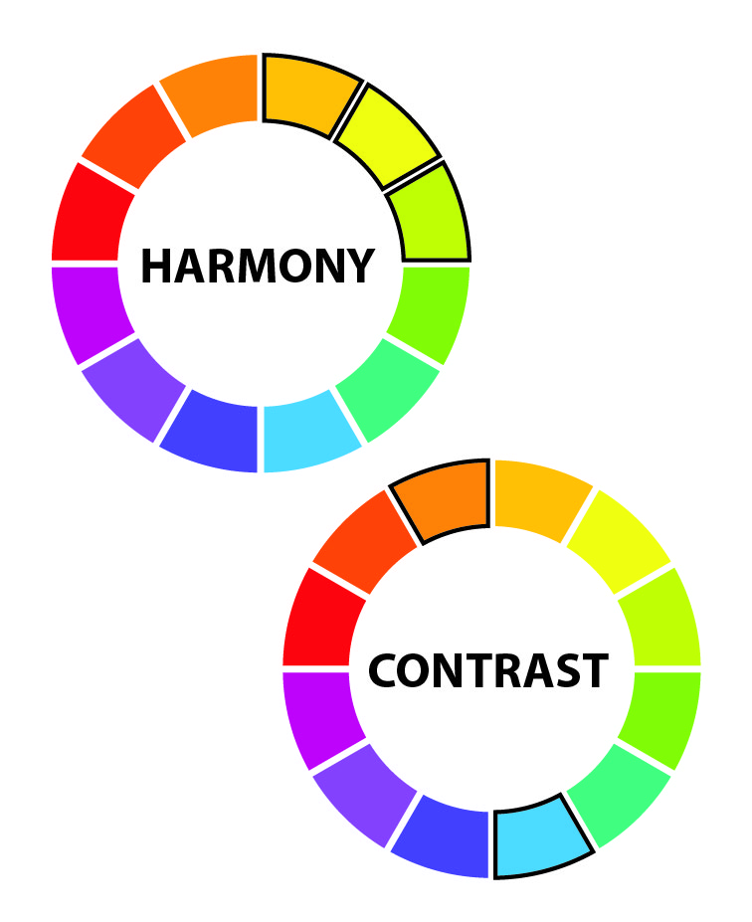
Tips for preparing slides:
Use colors wisely. Ones that harmonize to make a slide nice to look at or use contrasting colors to put emphasis on a crucial piece of information.
Use fonts that are easy to read. Don’t use fonts that are too decorated or hard to read. Don’t use too many different font sizes.
When you practise your speech, also practise changing slides. That helps you to find the right spots to change the slides naturally at the end of certain topics or other suitable moments.

Slide 7
Resources for slide presentations
Where to find good quality photographs?
Pexels
Pixabay: look for the images with the “Pixabay License”, which means they are free for commercial use and there is no attribution required.
Freeimages: after entering a search keyword, choose the “Free images” tab and scroll past the two rows of sponsored iStock images to get to the free-to-use content.
Which web applications to use to make interesting presentations? In addition to Google Slides, good web applications to check out are Emaze, Canva and Prezi.

Slide 8
Resources for slide presentations
Where to find interesting fonts? Follow the link below to get an overview of the most popular websites that offer fonts that are free to use and are intended for commercial use. Make sure to follow any conditions they might have about referencing the author of the font. https://designroast.org/places-find-free-commercial-use-fonts/

Slide 9
Thank you!
You can use the last slide to thank your audience for their attention or to make sure that a useful piece of information, for example contact information or a website, is memorable.
www.digiyouth.eu

