Slide 1
Introduction to Prototyping
Prototyping a physical product

Slide 2
Prototyping – What’s that?
A prototype is a preliminary version of a product from which all the later forms are developed.
The goal of a prototype is to evaluate an idea:
Will it work or how will it look?
Often the purpose of a physical prototype is to test the functionality of the product before a further investment.
Focus on what is important for your prototype:
functional or aesthetic?
You may not be able to reach both at once.
Testing and improving - the main reasons to prototype.

Slide 3
Visualizing - Moodboard
What is a moodboard?
Moodboard is a scrapbook or type of collage consisting of images (and sometimes text, and samples of objects in a composition).
Everyone’s got an opinion about the product and how the product should feel and look like. That´s why moodboard - as a tool - provides a good platform to throw ideas around and learn from each others ideas and opinions

Slide 4
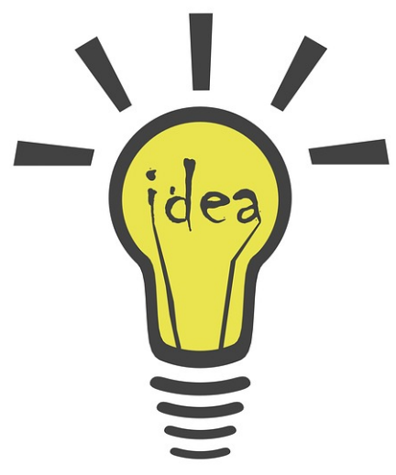
Visualizing - Moodboard
How do you see the product?
What is the style of the product?
How about the design (shape, details, etc.)?
How does the product feel?
What about the materials?
Materials relate directly to the cost of the product. Make sure to keep this in mind, when thinking of costs and budgeting.
What about the colours and visual things of the product?
Who an what will be your target audience?
The idea is that you present your ideas through pictures. You don’t have to find an exact picture about you’re product – instead the aim is to find pictures through which you can present your idea and produce a scrapbook or collage to support that idea.

Slide 5
Visualizing - Moodboard
Make your own moodboard
scrapbook or type of collage consisting of images (and if you want, you can add some text, and samples of objects in a composition).
Add at least 8 pictures
With those pictures, it is much more easier to discuss and tell your own visions to other members of your team
There’s two options:
make one Moodboard together or
Everyone can make their own moodboard
Remember!
This shouldn’t be a tought task. So don’t hesitate too much – just add pictures that represent your thoughts.
The idea is that, with pictures it is much more easier to tell your thoughts to your teammates.

Slide 6
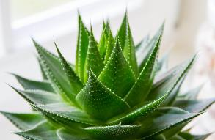
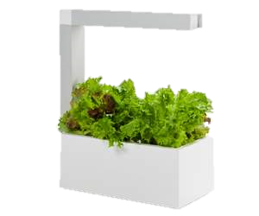
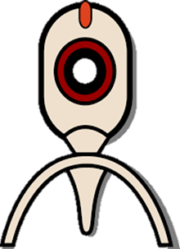
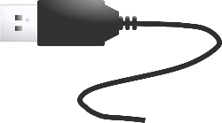
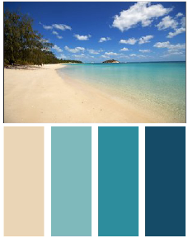
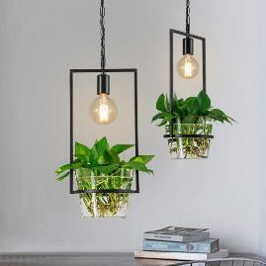
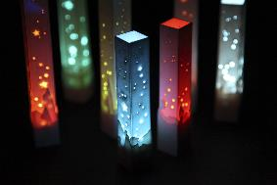
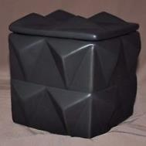
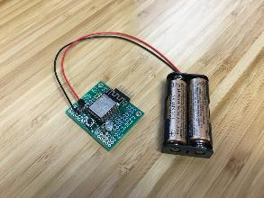
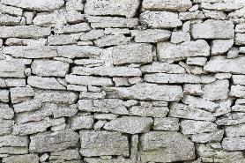
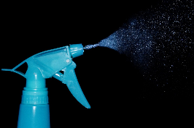
Visualizing – example of Moodboard
Moodboard example about Electronic plant growing station

Slide 7
Visualizing
Discuss about your ideas
What are the best parts of everyones different ideas?
Advantages / disadvantages?
Sum up your best ideas and just move on!

Slide 8
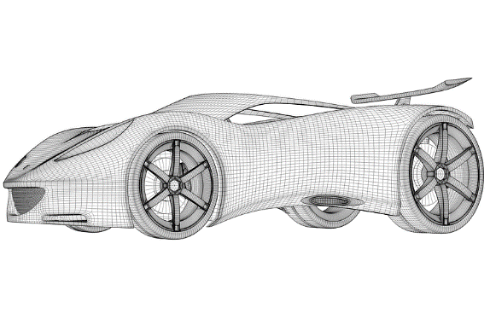
Creating a prototype
Materials are a very important part of physical products and need to be taken under consideration already when testing the functionality.
Discuss which would be best material for your prototype
Cardboard prototype?
Wood prototype?
Metal prototype?
3D pinted prototype?
Laser cutted prototype?
Hand Mouldable Plastics*?
Assortment of different materials?
*For example,
Shapelock is a plastic which melts when put in boiling water and then it can be moulded by hand into different shapes.
Sugru is a material which you can mould in your hands like a modelling clay. It dries after a day to a waterproof material (like silicone or rubber).

Slide 9
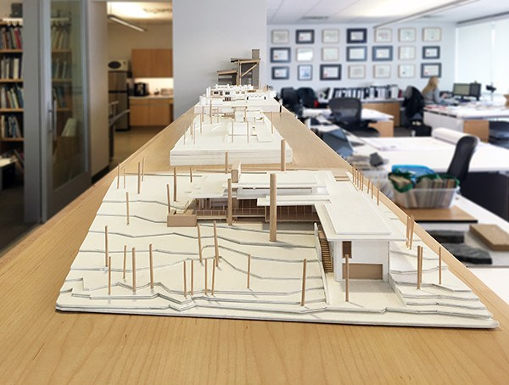
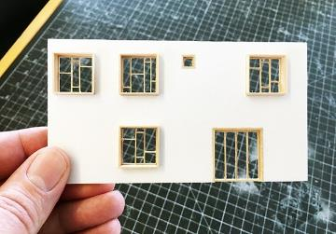
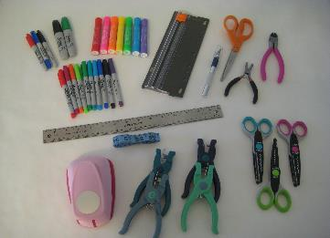

Slide 10
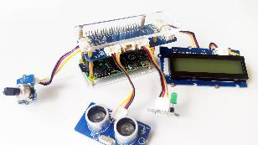
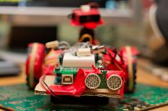
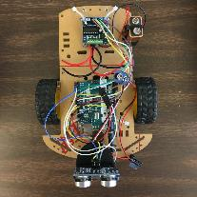
Creating a prototype
Creating a prototype - hands-on - gives you a physical product that can be experienced.
It provides valuable information and opportunities to rethink the structure and/or all the possible materials.
Generally prototyping results in the creation of multiple iterations or variations - observe and test to reach the model of the final product.
Prepare to prototype in cycles – build, test, change, build again, test, change etc.
Also discuss and try to find your teams personal advantages,
skills and abilities on different types of manufacturing.

Slide 11
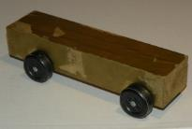
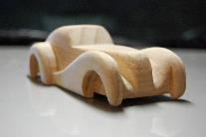
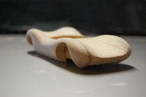
Different levels of prototypes Choose your own target level!
Low-fidelity prototypes are best for testing your core concepts and catching potential problems before they get too big to fix.
This type of prototype may or may not look like your final product at all
Mid-fidelity prototypes start to look like your final product. They are a good balance between visual design and functionality.
High-fidelity prototype may be also called as the pilot. It has been visually designed and constructed from real components and from the higher-grade materials.
Yet it's still considered as a prototype because of the need for quality reviews and final testing.

Slide 12
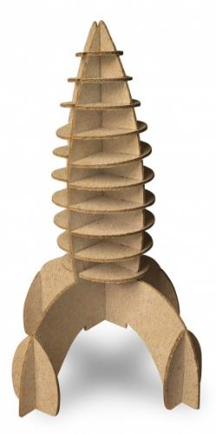
Prototyping - Action
Just start building - if you have any uncertainties about what you are trying to achieve, your best bet is to just make something.
Creating a prototype will help you to think about your idea in a concrete way.
Don’t spend too much time - it is important to remember that prototypes are supposed to be quick and easy for testing the solutions.
Remember what you’re testing for - focus on main issues and
build with the user in mind - test the prototype against your expected user needs. Observe and improve your ideas.
Start prototyping today and have fun along the way!
P.S. The constant problem-solving is an essential part of your prototyping – finding the solution usually presents many different options and creates your product to be even better.

